Slide 1
Jupyter Notebook Moment Tensor Decomposition Tool
A program to decompose a full moment tensor, plot deviatoric, double-couple and CLVD tensors, and plot the solution in source-type space

Slide 2
Some Reading

Slide 3
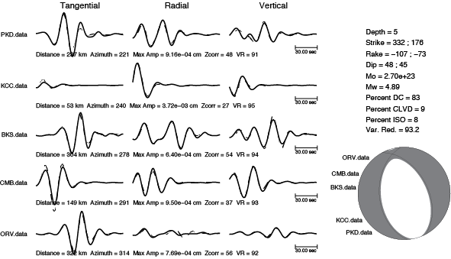
Example MT Inversion

Slide 4
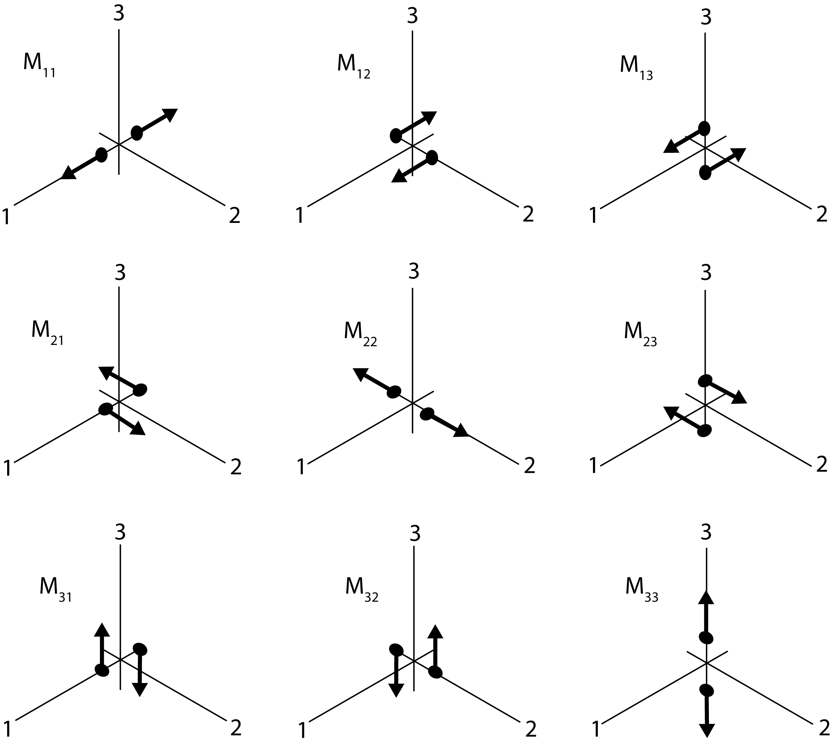
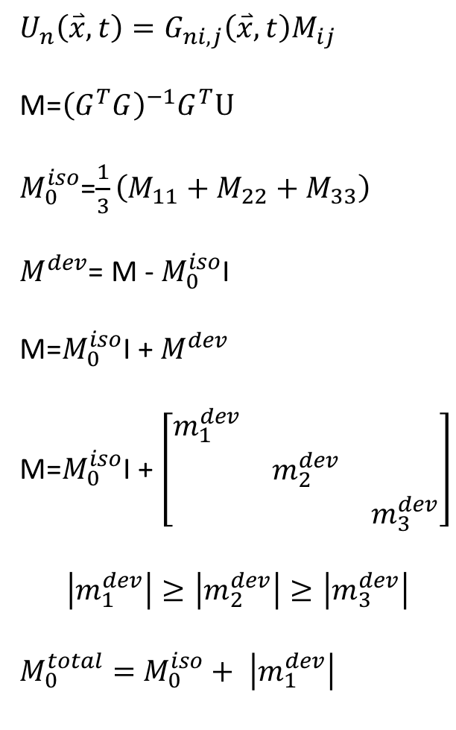
Moment Tensor Method
$$U_{n}\left(\overset{⃑}{x},t\right)=G_{ni,j}\left(\overset{⃑}{x},t\right)M_{ij}$$
M=${\left(G^{T}G\right)}^{−1}G^{T}U$
$M_{0}^{iso}$=$\frac{1}{3}\left(M_{11}+M_{22}+M_{33}\right)$
$M^{dev}$= M - $M_{0}^{iso}$I
M=$M_{0}^{iso}$I + $M^{dev}$
M=$M_{0}^{iso}\text{I}$ + $\left[\begin{matrix}m_{1}^{dev} & & \\ & m_{2}^{dev} & \\ & & m_{3}^{dev}\end{matrix}\right]$
$$\left|m_{1}^{dev}\right|≥\left|m_{2}^{dev}\right|≥\left|m_{3}^{dev}\right|$$
$M_{0}^{total}=$ $M_{0}^{iso}+ \left|m_{1}^{dev}\right|$

Slide 5
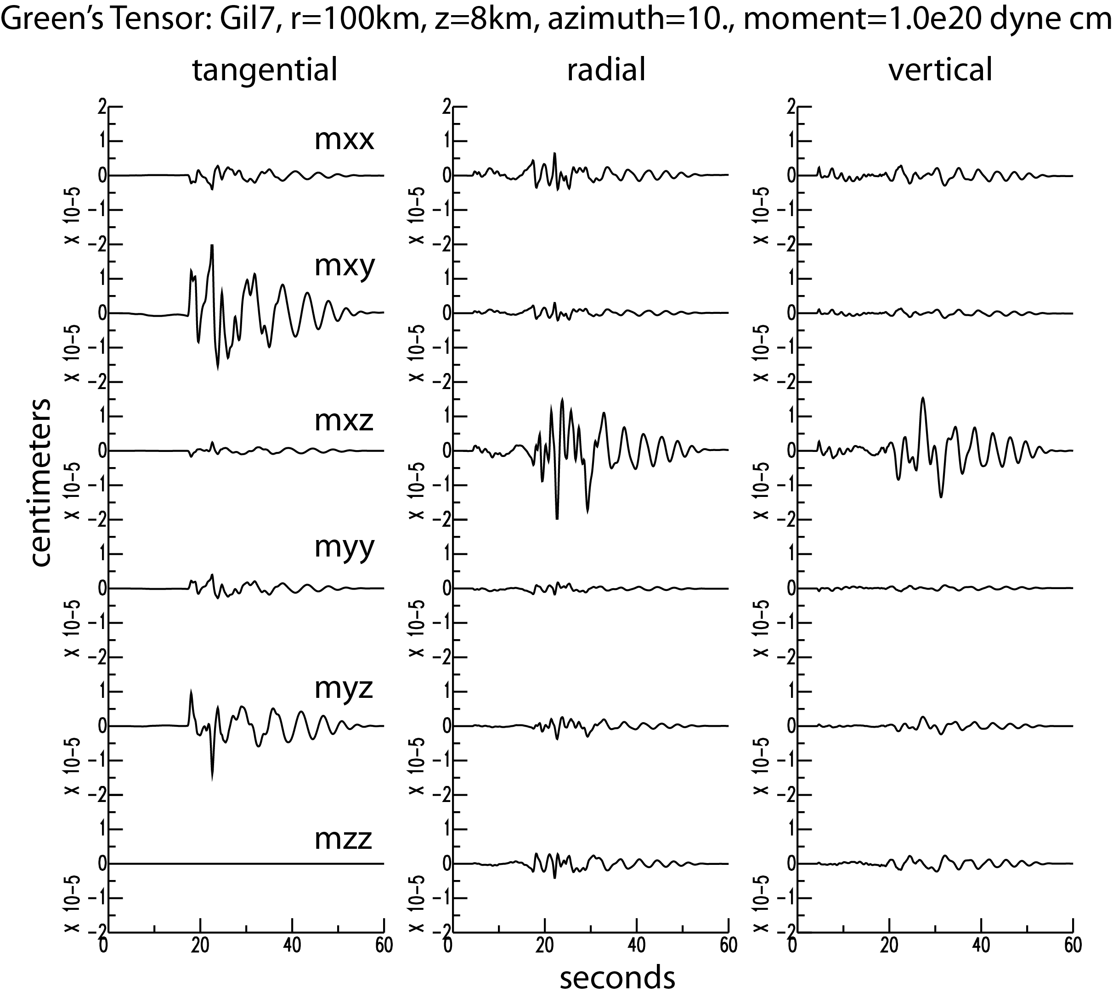

Slide 6
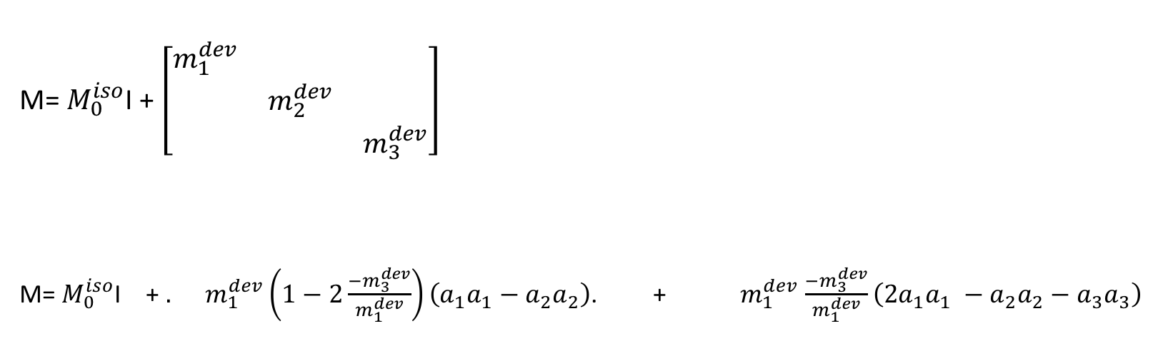
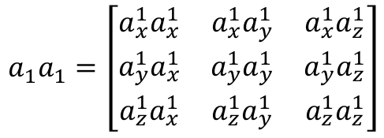
Moment Tensor Method
M= $M_{0}^{iso}\text{I}$ + $\left[\begin{matrix}m_{1}^{dev} & & \\ & m_{2}^{dev} & \\ & & m_{3}^{dev}\end{matrix}\right]$
M= $M_{0}^{iso}\text{I}$ + ${. m}_{1}^{dev}\left(1−2\frac{−m_{3}^{dev}}{m_{1}^{dev}}\right)\left(a_{1}a_{1}−a_{2}a_{2}\right)$. + $m_{1}^{dev}$ $\frac{−m_{3}^{dev}}{m_{1}^{dev}}\left(2a_{1}a_{1} −a_{2}a_{2}−a_{3}a_{3}\right)$
Compensated-Linear-Vector-Dipole (CLVD)
Double-couple
isotropic
$$a_{1}a_{1}=\left[\begin{matrix}{a_{x}^{1}a}_{x}^{1} & {a_{x}^{1}a}_{y}^{1} & a_{x}^{1}a_{z}^{1} \\ {a_{y}^{1}a}_{x}^{1} & a_{y}^{1}a_{y}^{1} & a_{y}^{1}a_{z}^{1} \\ a_{z}^{1}a_{x}^{1} & a_{z}^{1}a_{y}^{1} & a_{z}^{1}a_{z}^{1}\end{matrix}\right]$$
a¹ are eigenvectors and a₁a₁ are eigenvector dyadics

Slide 7
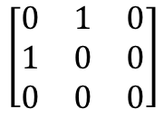
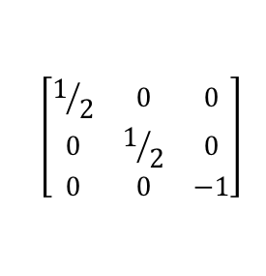
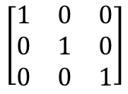
Seismic moment tensors
Model Source M Couples Focal
Example Type Mechanism
Double-couple (DC)
$$\left[\begin{matrix}0 & 1 & 0 \\ 1 & 0 & 0 \\ 0 & 0 & 0\end{matrix}\right]$$
x
Fault-slip
x
y
y
z
Compensated linear vector dipole (CLVD)
$$\left[\begin{matrix}1/2 & 0 & 0 \\ 0 & 1/2 & 0 \\ 0 & 0 & −1\end{matrix}\right]$$
x
x
Ring Fault
y
y
z
$$\left[\begin{matrix}1 & 0 & 0 \\ 0 & 1 & 0 \\ 0 & 0 & 1\end{matrix}\right]$$
x
Isotropic
x
Explosion
y
y
z
z
Notes:
Some earthquake mechanisms and their moment tensor representation
Since its symmetric we can diagonalize
The principal axes are the T (max tension; 1),N, and P (max compression; -1) axes
TRANS: Motivation - if we can get at the source moment tensor we can find whether the event is slip on a plane (earthquake) or pressure pulse
Maybe board stuff for isotropic and deviatoric
Force deviatoric = zero trace
***Deviatoric sources = trace is 0 - no volume
***Isotropic source = trace is nonzero - volume change
The tool we use to calculate this moment tensor is a regional linear inversion

Slide 8
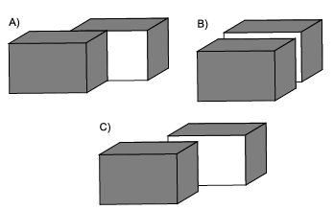
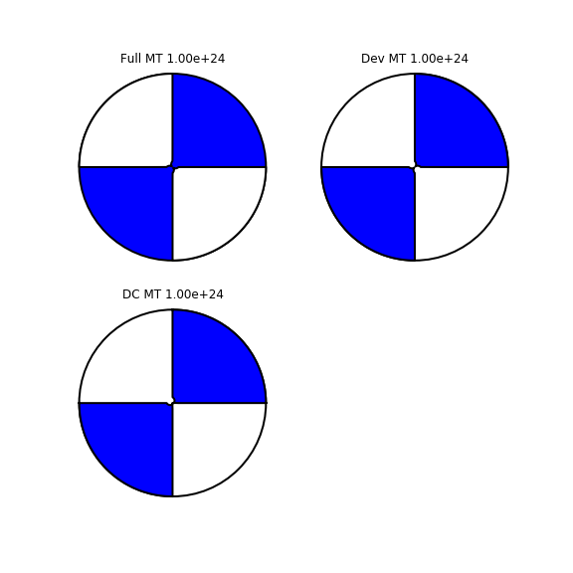
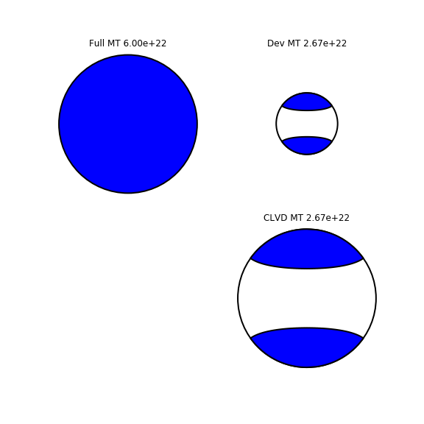
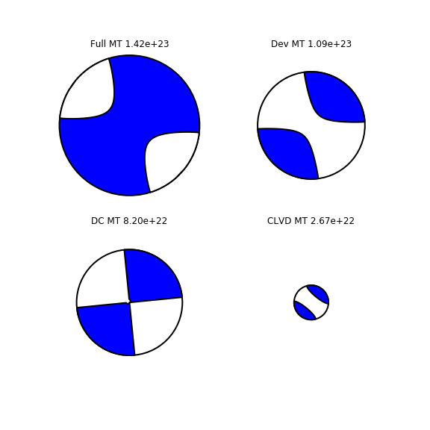
Shear Fault
Tensile Crack
Crack-Double-Couple
Double-Couple
Tensile Crack
Crack-Double-Couple

Slide 9
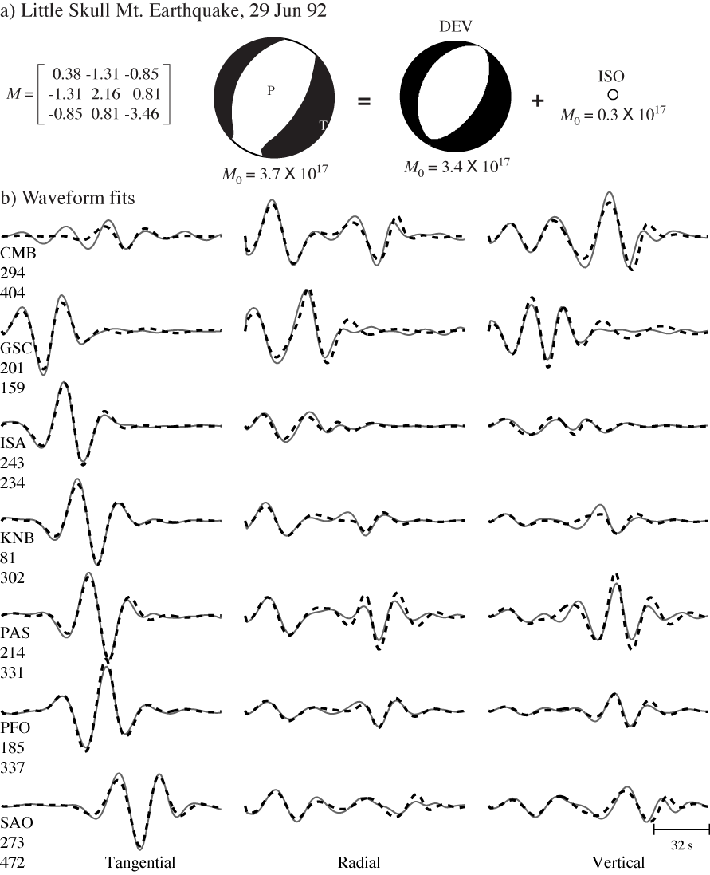
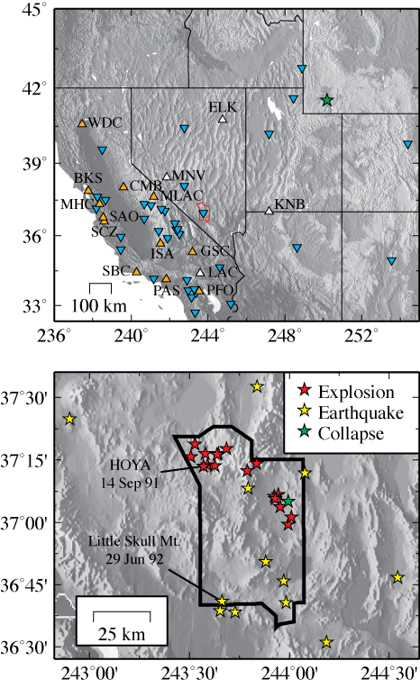
Western US
Ford et al., 2009

Slide 10
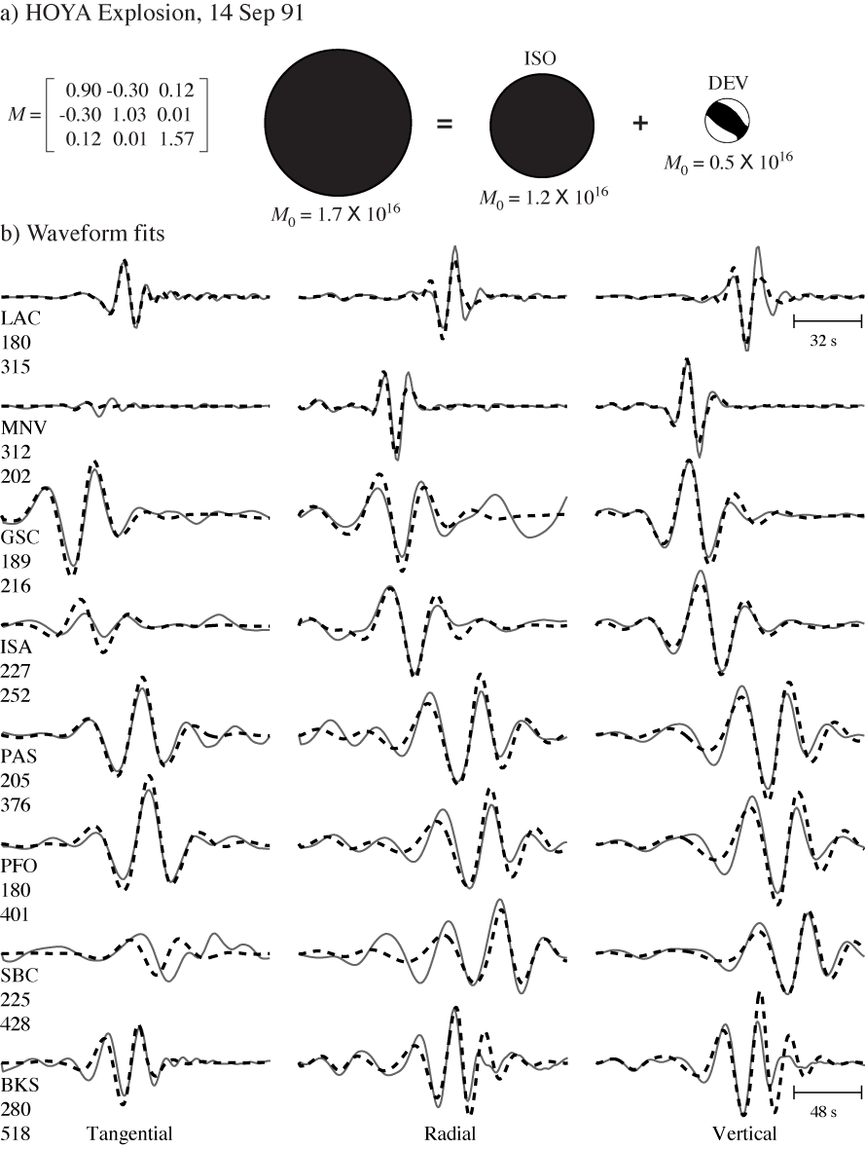
Western US
Ford et al., 2009

Slide 11
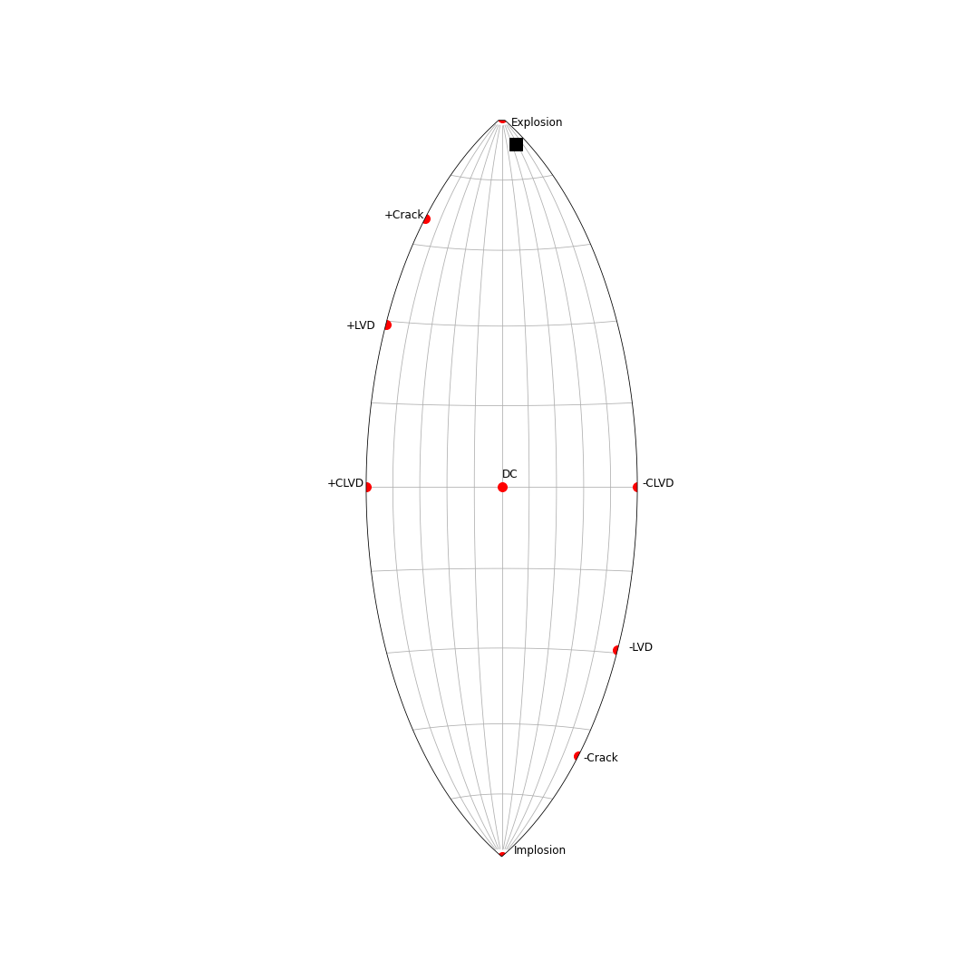
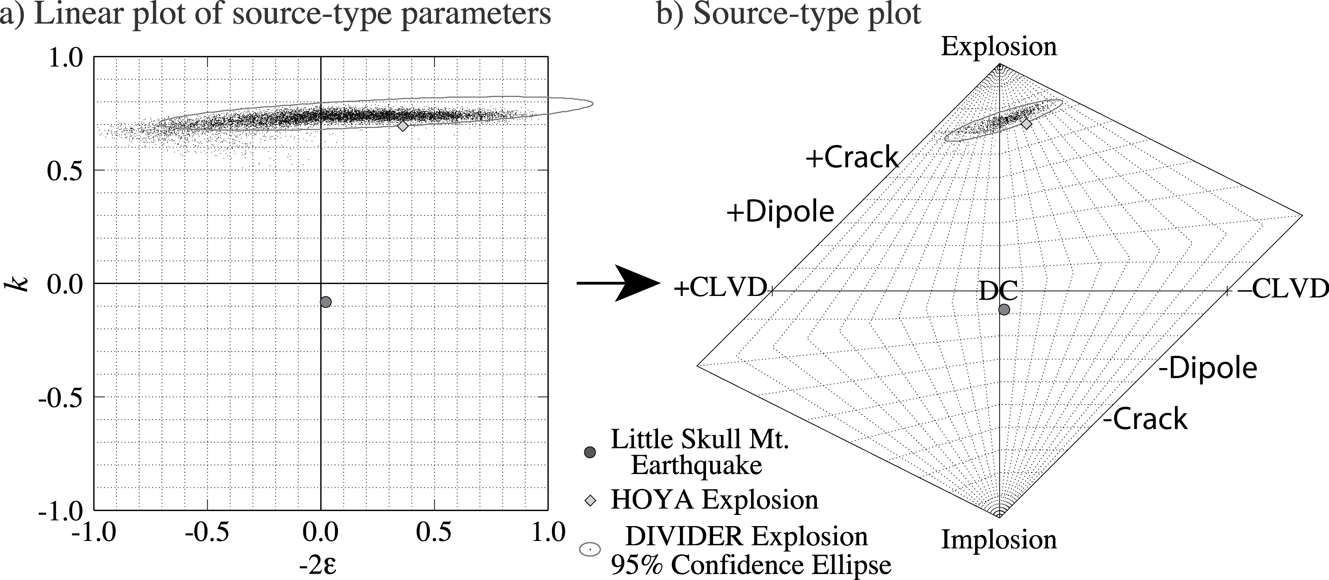
Hudson Source-Type Plot (Hudson et al., 1989)
c) Tape and Tape (2012) Lune
m are eigenvalues
λ are eigenvalues
From Ford et al. (2010)
γ is longitude, δ is latitude and β is colatitude on a unit sphere

Slide 12
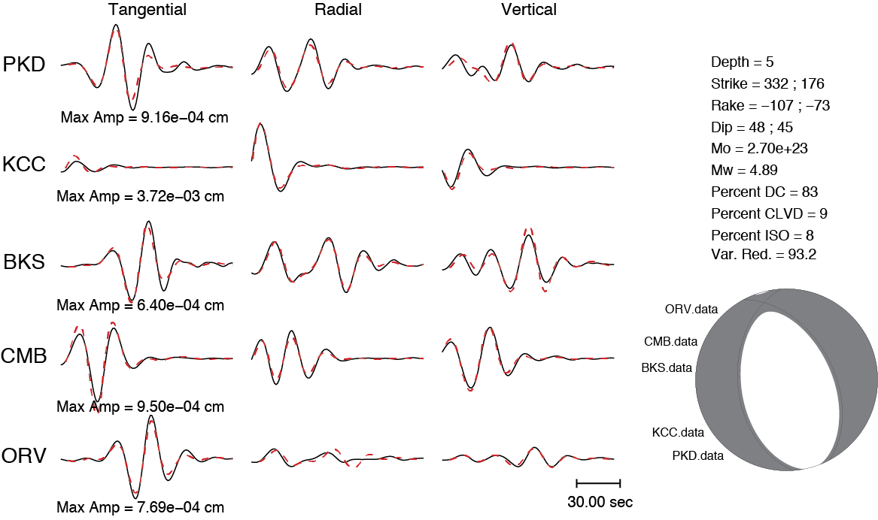
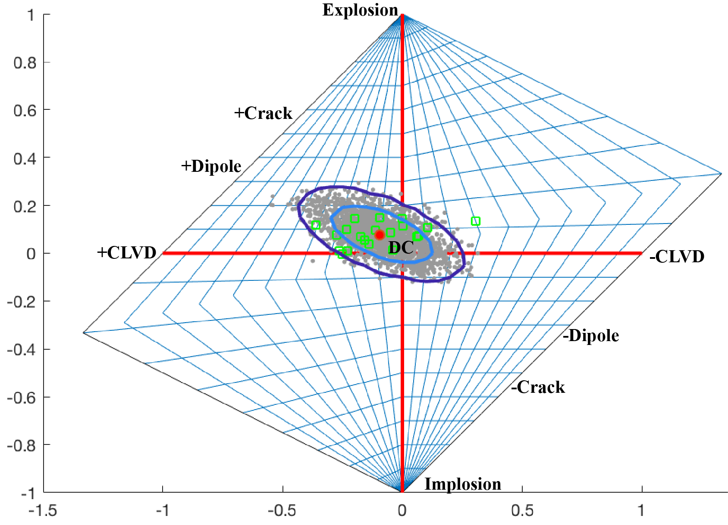
Source-Type Projection
&
Uncertainties
Residual Bootstrap
Jackknife 3-Component Stations

Slide 13
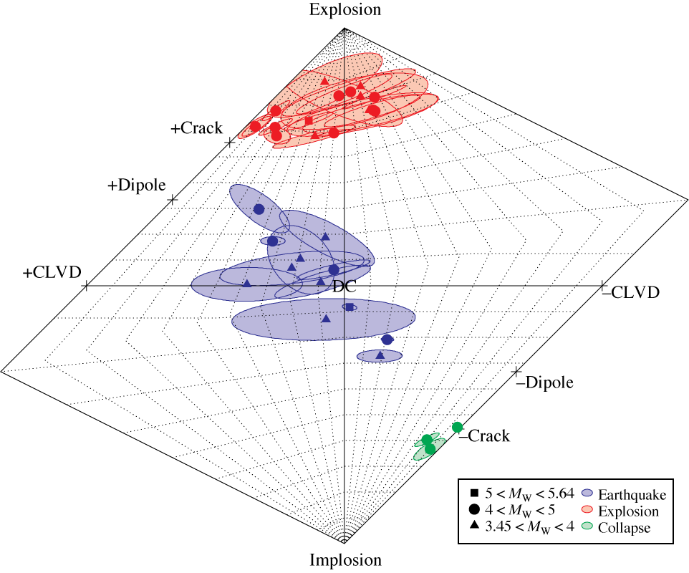
Western US
Ford et al. (2009)
Notes:
17 explosions
12 earthquakes
3 collapses

Slide 14
Jupyter Notebook MT Decomposition Tool
Enter a moment tensor
Optionally enter a filename containing a source-type fitting parameter
Decompose the moment tensor and provide information on the scalar moment, moment magnitude and the isotropic, deviatoric, double-couple and CLVD components
Graphically plot the moment tensor in source-type space
Optionally plot a source-type fitting parameter distribution

